Slide 1
Final exam
Yuan Sun

Slide 2
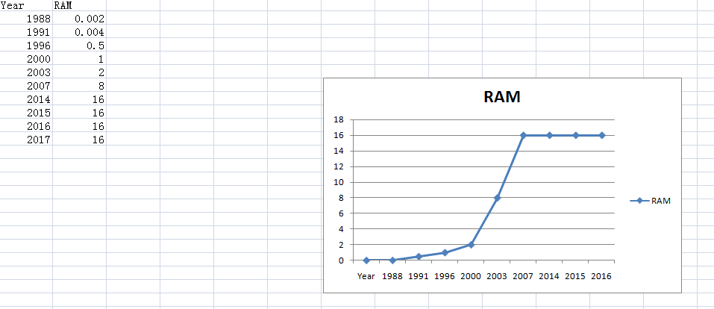
hw1

Slide 3
Logistic regression
Yuan Sun

Slide 4
Logistic regression is used in various fields, including machine learning, most medical fields, and social sciences. For example, the Trauma and Injury Severity Score (TRISS), which is widely used to predict mortality in injured patients, was originally developed by Boyd et al. using logistic regression.

Slide 5
In economic it can be used to predict the likelihood of a person's choosing to be in the labor force, and a business application would be to predict the likelihood of a homeowner defaulting on a mortgage. Conditional random fields, an extension of logistic regression to sequential data, are used in natural language processing.

Slide 6
hw2
ex1 and ex2
hw1.df = read.csv("hw1.csv",header = TRUE)
plot(hw1.df$ram~hw1.df$year)
splines.reg.l = smooth.spline(x = hw1.df$year, y = hw1.df$ram, spar = 0.2)
splines.reg.2 = smooth.spline(x = hw1.df$year, y = hw1.df$ram, spar = 1)
splines.reg.3= smooth.spline(x = hw1.df$year, y = hw1.df$ram, spar = 2)
lines(splines.reg.1, col = "red", lwd = 2) # regression line with lambda = 0.2
lines(splines.reg.2, col = "green", lwd = 2) # regression line with lambda = 1
lines(splines.reg.3, col = "blue", lwd = 2) # regression line with lambda = 2

Slide 7
Hw2
Ex 3
x = 6
n = 1000
lambda = 2
p = lambda / n
dbinom (x,2*n,p) # binomial probability mass function
dpois (x, 2*lambda ) # Poisson probability mass function
dpois (0, 5 )

Slide 8
hw3
HW3-1
install.packages("digest",repos='http://cran.us.r-project.org')
library("digest")
digest("I learn a lot from this class when I am proper listening to the professor","sha256")
digest("I do not learn a lot from this class when i am absent and playing on my Iphone","sha256")

Slide 9
hw3
HW3-4
install.packages("rjson",repos = "http://cran.us.r-project.org")
library("rjson")
json_file="http://crix.hu-berlin.de/data/crix.json"
json_data=fromJSON(file=json_file)
crix_data_frame=as.data.frame(json_data)
crix_data_frame_t<-t(crix_data_frame)
time<-crix_data_frame_t[seq(1,2350,by=2)]
price<-crix_data_frame_t[seq(2,2350,by=2)]
crix_data_frame<-cbind(time,price)
time_series<-ts(data=price,start =c(2014,7,31),frequency = 365)
plot(time_series)
install.packages("tseries")
library(tseries)
adf.test(time_series)
#Because p-value is greater than printed p-value, we can't reject the hypothesis#

Slide 10
Digital Signature Algorithms
Yuan Sun

Slide 11
The Digital Signature Algorithm (DSA) is a Federal Information Processing Standard for digital signatures.for the key generation, it has two phases. The first phase is a choice of algorithm parameters which may be shared between different users of the system, while the second phase computes public and private keys for a single user.

Slide 12
For the Parameter generation, the steps are: Choose an approved cryptographic hash function H; Decide on a key length L and N which is the primary measure of the cryptographic strength of the key; Choose an N-bit prime q; Choose an L-bit prime p such that p − 1 is a multiple of q; Choose g, a number whose multiplicative order modulo p is q.
The algorithm parameters (p, q, g) may be shared between different users of the system.

Slide 13
Per-user keys: Given a set of parameters, the second phase computes private and public keys for a single user. Apart from these, we also need signing and verifying process, then check the Correctness of the algorithm

Slide 14
JSON data
Create a JSON data set
library(rjsonio)
Num <- [1:5]
Name <- c(“aaa”, ”bbb”, ”cccc”, “ddd”, “eee”)
data <- as.matrix(data.frame(Num,Name))
cat(toJSON(data))
Note: JSON data is a key-value pairs list.

Slide 15
2. Read the JSON data set
library("rjson")
json_data = fromJSON(file=data)
We can use function ‘fromJSON’ to read the JSON data set

Slide 16
2. Read the JSON data set
library("rjson")
json_data = fromJSON(file=data)
We can use function ‘fromJSON’ to read the JSON data set

Slide 17
Homework 4
Yuan Sun

Slide 18
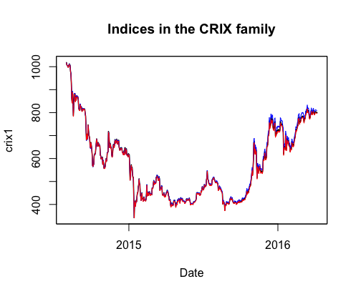
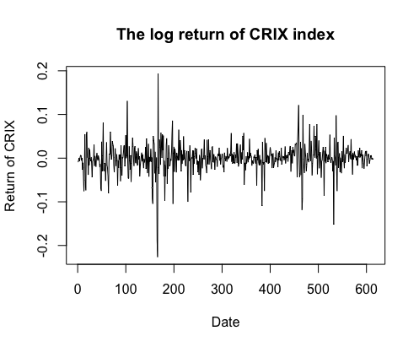
1. Improve the R quantlets on GH (from CRIX directory on quantlet.de) and make excellent graphics that follow Fig 3,4,5,6 of the ”Econometrics of CRIX“ paper.
Figure 3: The daily value of indices in the CRIX family
Figure 4: The log returns of CRIX index

Slide 19
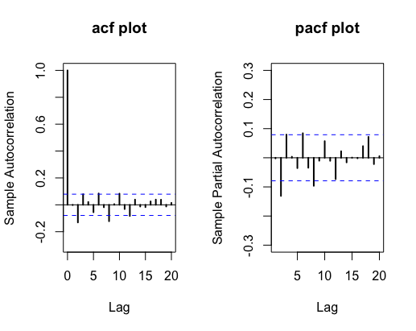
Figure 5: Histogram and QQ plot of CRIX returns
Figure 6: The sample ACF and PACF of CRIX returns
rm(list = ls(all = TRUE))
graphics.off()
# install and load packages
libraries = c("zoo", "tseries", "xts","ccgarch")
lapply(libraries, function(x) if (!(x %in% installed.packages())) { install.packages(x)}

Slide 20
lapply(libraries, library, quietly = TRUE, character.only = TRUE)
# load dataset
load(file.choose())
load(file.choose())
load(file.choose())
# three indices return
ecrix1 = zoo(ecrix, order.by = index(crix1))
efcrix1 = zoo(efcrix, order.by = index(crix1))
# plot with different x-axis scales with zoo
my.panel <- function(x, ...) {
lines(x, ...)
lines(ecrix1, col = "blue")
lines(efcrix1, col = "red")
}
plot.zoo(crix1, plot.type = "multiple", type = "l", lwd = 1.5, panel = my.panel,
main = "Indices in the CRIX family", xlab = "Date")

Slide 21
# plot of crix
# plot(as.xts(crix), type="l", auto.grid=FALSE, main = NA)
plot(crix1, ylab = "Price of CRIX", xlab = "Date")
# plot of crix return
ret = diff(log(crix1))
# plot(as.xts(ret), type="l", auto.grid=FALSE, main = NA)
plot(ret, ylab = "Return of CRIX", xlab = "Date")
# stationary test
adf.test(ret, alternative = "stationary")
kpss.test(ret, null = "Trend")
par(mfrow = c(1, 2))
# histogram of returns
hist(ret, col = "grey", breaks = 20, freq = FALSE, ylim = c(0, 25), xlab = "Return of CRIX")
lines(density(ret), lwd = 2)
mu = mean(ret)
sigma = sd(ret)
x = seq(-4, 4, length = 100)
curve(dnorm(x, mean = mean(ret), sd = sd(ret)), add = TRUE, col = "red",
lwd = 2)

Slide 22
# qq-plot
qqnorm(ret)
qqline(ret, col = "blue", lwd = 3)
# acf plot
autocorr = acf(ret, lag.max = 20, ylab = "Sample Autocorrelation", main = "acf plot",
lwd = 2, ylim = c(-0.3, 1))
# pacf plot
autopcorr = pacf(ret, lag.max = 20, ylab = "Sample Partial Autocorrelation",
main = "pacf plot", ylim = c(-0.3, 0.3), lwd = 2)

Slide 23
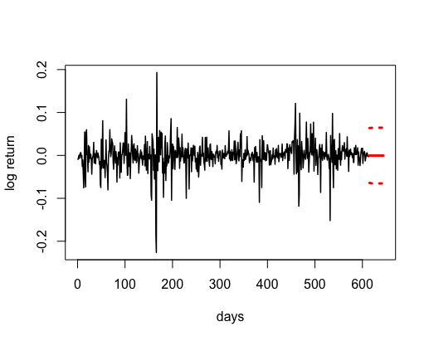
Q2. Make your R code perfect as in the R examples on quantlet.de i.e. make sure that the
code is ”time independent“ by using actual dimensions of the data that you are collecting
from crix.hu-berlin.de Recreate Fig 7 from ”Econometrics of CRIX“.
Figure 7: CRIX returns and predicted values.

Slide 24
Codes:
# arima model
par(mfrow = c(1, 1))
fit1 = arima(ret, order = c(1, 0, 1))
tsdiag(fit1)
Box.test(fit1$residuals, lag = 1)
# aic
aic = matrix(NA, 6, 6)
for (p in 0:4) {
for (q in 0:3) {
a.p.q = arima(ret, order = c(p, 0, q))
aic.p.q = a.p.q$aic
aic[p + 1, q + 1] = aic.p.q
}
}
# bic
bic = matrix(NA, 6, 6)
for (p in 0:4) {
for (q in 0:3) {
b.p.q = arima(ret, order = c(p, 0, q))
bic.p.q = AIC(b.p.q, k = log(length(ret)))
bic[p + 1, q + 1] = bic.p.q
}
}
# select p and q order of ARIMA model
fit4 = arima(ret, order = c(2, 0, 3))
tsdiag(fit4)
Box.test(fit4$residuals, lag = 1)
fitr4 = arima(ret, order = c(2, 1, 3))
tsdiag(fitr4)
Box.test(fitr4$residuals, lag = 1)

Slide 25
# to conclude, 202 is better than 213
fit202 = arima(ret, order = c(2, 0, 2))
AIC(fit202, k = log(length(ret)))
AIC(fit4, k = log(length(ret)))
AIC(fitr4, k = log(length(ret)))
fit202$aic
fit4$aic
fitr4$aic
# arima202 predict
predict_num = 30
fit202 = arima(ret, order = c(2, 0, 2))
crpre = predict(fit202, n.ahead = predict_num)
dates = seq(as.Date("02/08/2014", format = "%d/%m/%Y"), by = "days", length = length(ret))
plot(ret, type = "l", xlim = c(0, length(ret)+predict_num), ylab = "log return", xlab = "days",
lwd = 1.5, col = "black")
lines(crpre$pred, col = "red", lwd = 3)
lines(crpre$pred + 2 * crpre$se, col = "red", lty = 3, lwd = 3)
lines(crpre$pred - 2 * crpre$se, col = "red", lty = 3, lwd = 3)

Slide 26
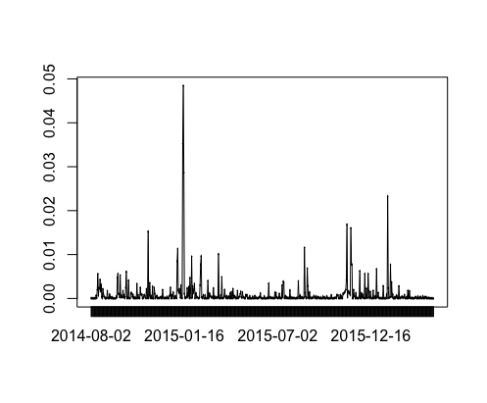
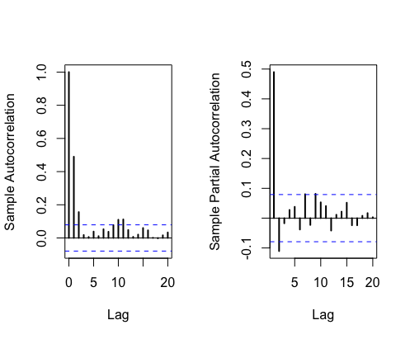
Q3. Redo as many ﬁgures as you can.
Figure 8: The squared ARIMA(2,0,2) residuals of CRIX returns.
Figure 9: The ACF and PACF of squared ARIMA(2,0,2) residuals

Slide 27
Codes:
rm(list = ls(all = TRUE))
graphics.off()
# install and load packages
libraries = c("tseries")
lapply(libraries, function(x) if (!(x %in% installed.packages())) {
install.packages(x)
})
lapply(libraries, library, quietly = TRUE, character.only = TRUE)
# please change your working directory
setwd()
load(file.choose())
Pr = as.numeric(crix)
Da = factor(date1)
crx = data.frame(Da, Pr)
# plot of crix return
ret = diff(log(crx$Pr))
Dare = factor(date1[-1])
retts = data.frame(Dare, ret)
# arima202 predict
fit202 = arima(ret, order = c(2, 0, 2))
# vola cluster
par(mfrow = c(1, 1))
res = fit202$residuals
res2 = fit202$residuals^2
tsres202 = data.frame(Dare, res2)
plot(tsres202$Dare, tsres202$res2, type = "o", ylab = NA)
lines(tsres202$res2)
# plot(res2, ylab='Squared residuals', main=NA)
par(mfrow = c(1, 2))
acfres2 = acf(res2, main = NA, lag.max = 20, ylab = "Sample Autocorrelation", lwd = 2)
pacfres2 = pacf(res2, lag.max = 20, ylab = "Sample Partial Autocorrelation", lwd = 2, main = NA)

Slide 28
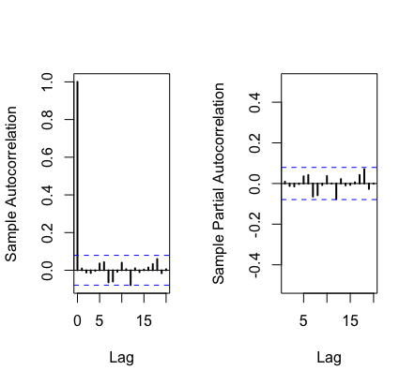
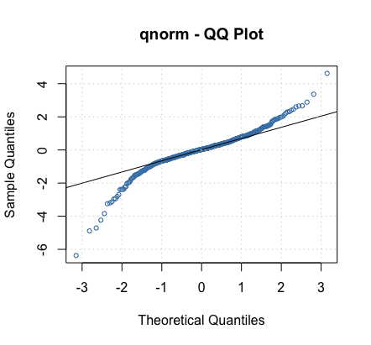
Figure 10: The ACF and PACF of squared ARIMA(2,0,2) residuals
Figure 11: The QQ plots of model residuals of ARIMA-GARCH process.

Slide 29
Codes:
rm(list = ls(all = TRUE))
graphics.off()
# install and load packages
libraries = c("forecast", "fGarch")
lapply(libraries, function(x) if (!(x %in% installed.packages())) {
install.packages(x)
})
lapply(libraries, library, quietly = TRUE, character.only = TRUE)
# load dataset
load(file.choose())
ret = diff(log(crix1))
# vol cluster
fit202 = arima(ret, order = c(2, 0, 2))
par(mfrow = c(1, 1))
res = fit202$residuals
res2 = fit202$residuals^2
# different garch model
fg11 = garchFit(data = res, data ~ garch(1, 1))
summary(fg11)
fg12 = garchFit(data = res, data ~ garch(1, 2))
summary(fg12)
fg21 = garchFit(data = res, data ~ garch(2, 1))
summary(fg21)
fg22 = garchFit(data = res, data ~ garch(2, 2))
summary(fg22)
# residual plot
reszo = zoo(fg11@residuals, order.by = index(crix1))
plot(reszo, ylab = NA, lwd = 2)

Slide 30
par(mfrow = c(1, 2))
fg11res2 = fg11@residuals
acfres2 = acf(fg11res2, lag.max = 20, ylab = "Sample Autocorrelation",
main = NA, lwd = 2)
pacfres2 = pacf(fg11res2, lag.max = 20, ylab = "Sample Partial Autocorrelation",
main = NA, lwd = 2, ylim = c(-0.5, 0.5))
fg12res2 = fg12@residuals
acfres2 = acf(fg12res2, lag.max = 20, ylab = "Sample Autocorrelation",
main = NA, lwd = 2)
pacfres2 = pacf(fg12res2, lag.max = 20, ylab = "Sample Partial Autocorrelation",
main = NA, lwd = 2, ylim = c(-0.5, 0.5))
# qq plot
par(mfrow = c(1, 1))
plot(fg11, which = 13) #9,10,11,13

Slide 31
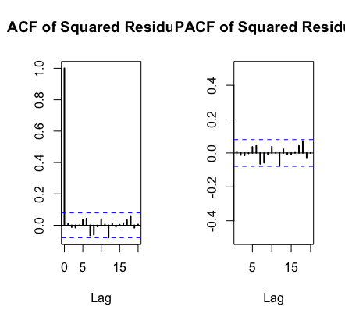
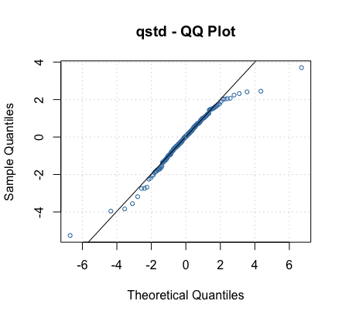
Figure 12: The ACF and PACF plots for model residuals of ARIMA(2,0,2)- t-GARCH(1,1) process.
Figure 13: The QQ plots of model residuals of ARIMA-t-GARCH process.

Slide 32
Codes:
fg11stu = garchFit(data = res, data ~ garch(1, 1), cond.dist = "std")
# different forecast with t-garch
# fg11stufore = predict(fg11stu, n.ahead = 30, plot=TRUE, mse='uncond', auto.grid=FALSE)
fg11stufore = predict(fg11stu, n.ahead = 30, plot = TRUE, cond.dist = "QMLE",
auto.grid = FALSE)
par(mfrow = c(1, 2))
stu.fg11res2 = fg11stu@residuals
# acf and pacf for t-garch
stu.acfres2 = acf(stu.fg11res2, ylab = NA, lag.max = 20, main = "ACF of Squared Residuals",
lwd = 2)
stu.pacfres2 = pacf(stu.fg11res2, lag.max = 20, main = "PACF of Squared Residuals",
lwd = 2, ylab = NA, ylim = c(-0.5, 0.5))
# ARIMA-t-GARCH qq plot
par(mfrow = c(1, 1))
plot(fg11stu, which = 13)

